Slide 1
2020.12.12日 组会汇报
Eyeriss: An Energy-Efficient Reconfigurable Accelerator for Deep Convolutional Neural Networks
IEEE JOURNAL OF SOLID-STATE CIRCUITS

Slide 2
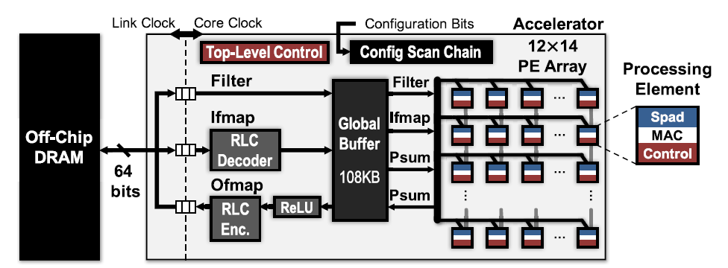
Eyeriss system architecture
Notes:
两个时钟
168个PE单元
PE里面有MAC计算单元，control的控制，Spad里面存储数据（ｗ，ｉｆ，psum）

Slide 3
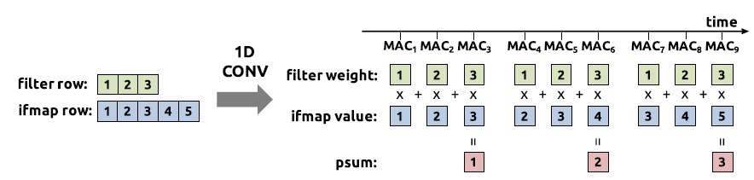
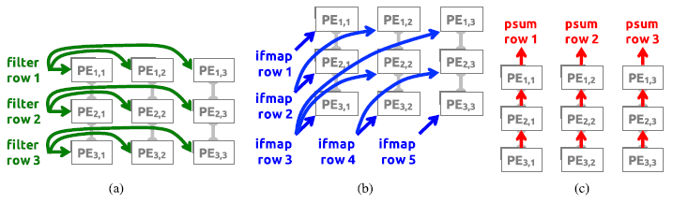
Dataflow in PEs
Notes:
Filter的row传到1row的PE里面，ifmap按照对角线传到PE矩阵，然后PE的值纵向加起来

Slide 4
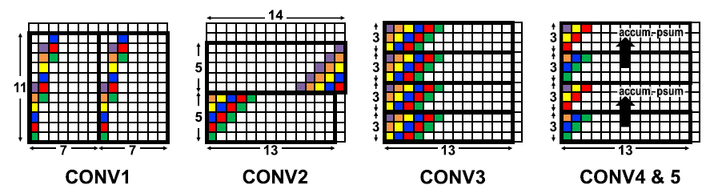
PE Sets

Slide 5
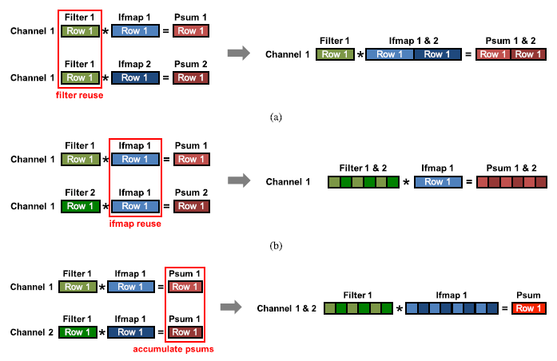
SCNN DATAFLOW

Slide 6
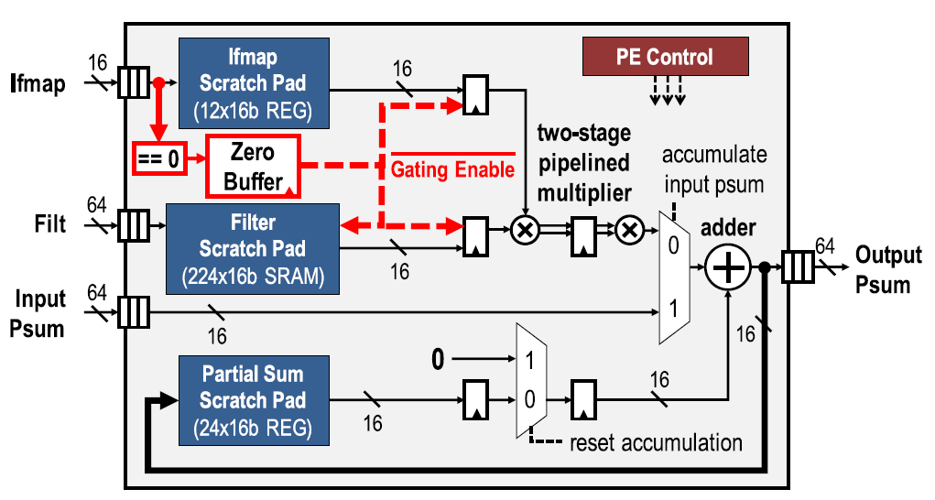
PE Architecture

Slide 7
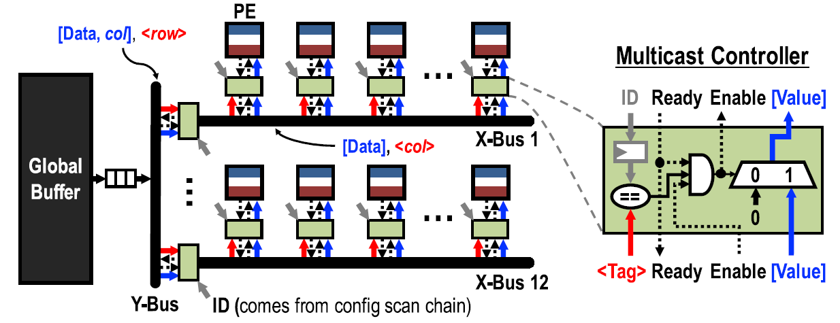
Architecture of the GIN

Slide 8
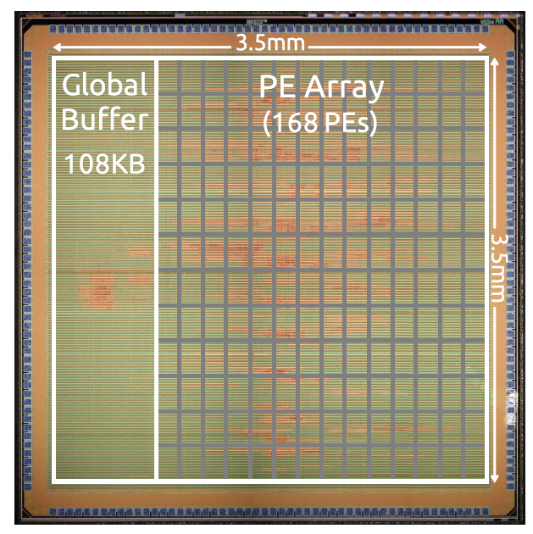
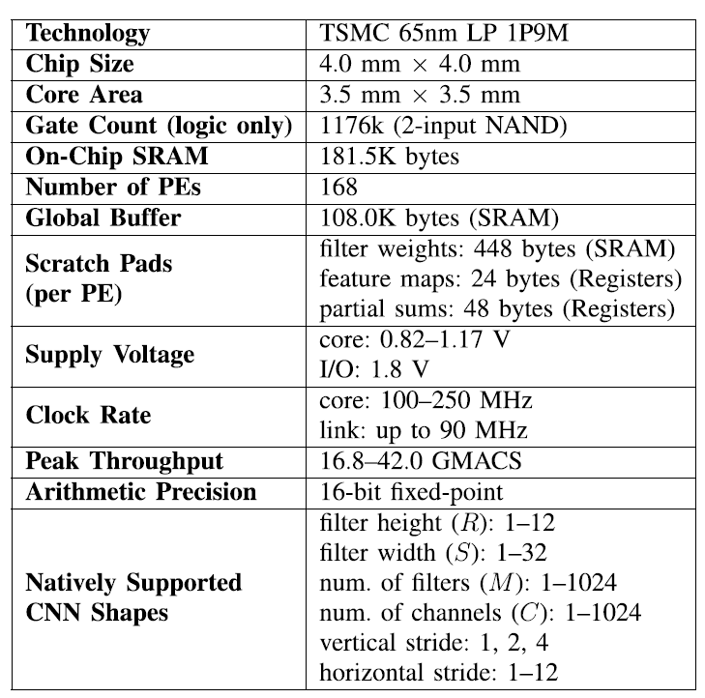

Slide 9
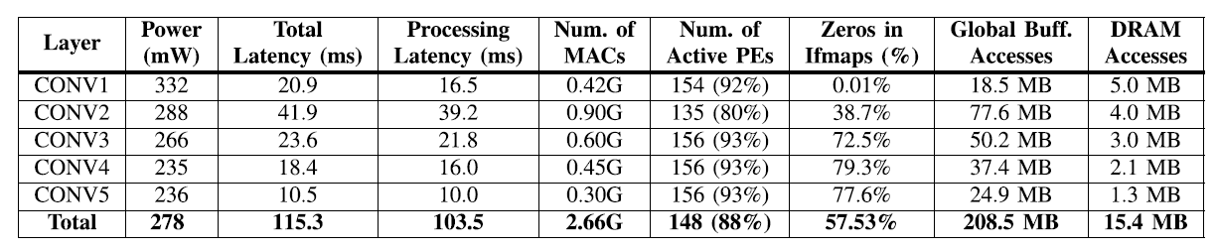
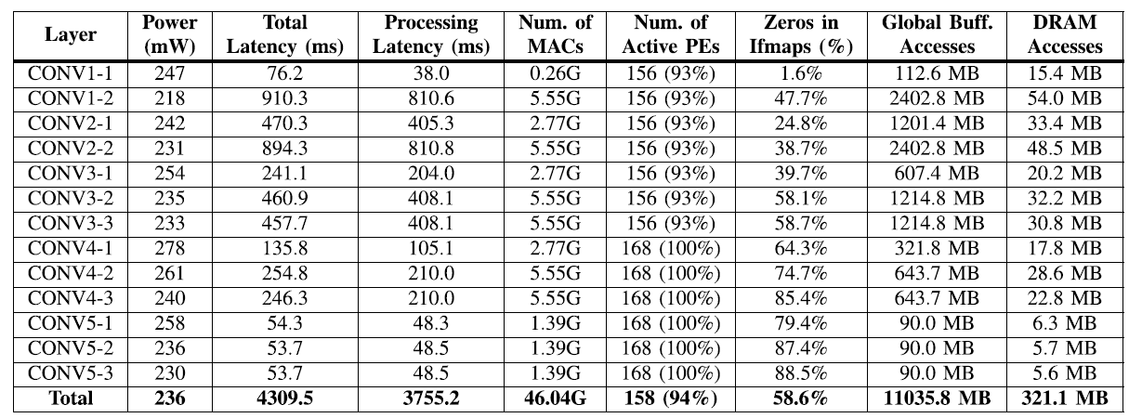
AlexNet
Vgg16

